Slide 1


SocialBuzz Data Analysis and Insights Unveiling

Slide 2


Today's agenda
Project recap
Problem
The Analytics team
Process
Insights
Summary

Slide 3
Project Overview:
Accenture has been engaged by Social Buzz, a social media and content creation company, to provide advisory services and assist them with their scaling process. The project aims to address their immediate needs, prepare them for a successful IPO, and enhance their big data practices.
Project Objectives:
An audit of their big data practice.
Assist with a successful IPO process
Top 5 Content Categories Analysis
Project Deliverables:
Big data practice audit and recommendations
IPO best practice document
Content category analysis (top 5 popular categories)
Data extraction, merging, and analysis
Technology architecture workshop and stress testing
Best practices presentation and knowledge sharing
Data center audit
Accenture sandbox database integration
Engagement Period: 3 months
Project Recap

Slide 4

Problem
Analysis Complexity: SocialBuzz faces challenges in analyzing their diverse data, which includes text, images, videos, and GIFs.
Popularity Identification: SocialBuzz needs assistance in analyzing their content categories to identify the top 5 categories with the highest aggregate popularity.
Data Extraction and Integration: SocialBuzz requires support in extracting and integrating relevant data sets for analysis.
Visualization and Insights: SocialBuzz seeks assistance in visually presenting analysis results and deriving meaningful insights from their data.
Data Governance: SocialBuzz requires guidance in establishing robust data governance practices for their analysis processes. Ensuring data quality, accuracy, and compliance with privacy regulations is crucial for meaningful analysis.

Slide 5



Andrew Flemming
Chief Technology Architect
The Analytics team
Marcus Rompton
Senior Principal
Ibrahim Parkar
Data analyst

Slide 6

Process
1
Understanding Data
2
Cleaning the Data
3
Modelling Data
4
Data Analysis
5
Unearthing Valuable Insights

Slide 7
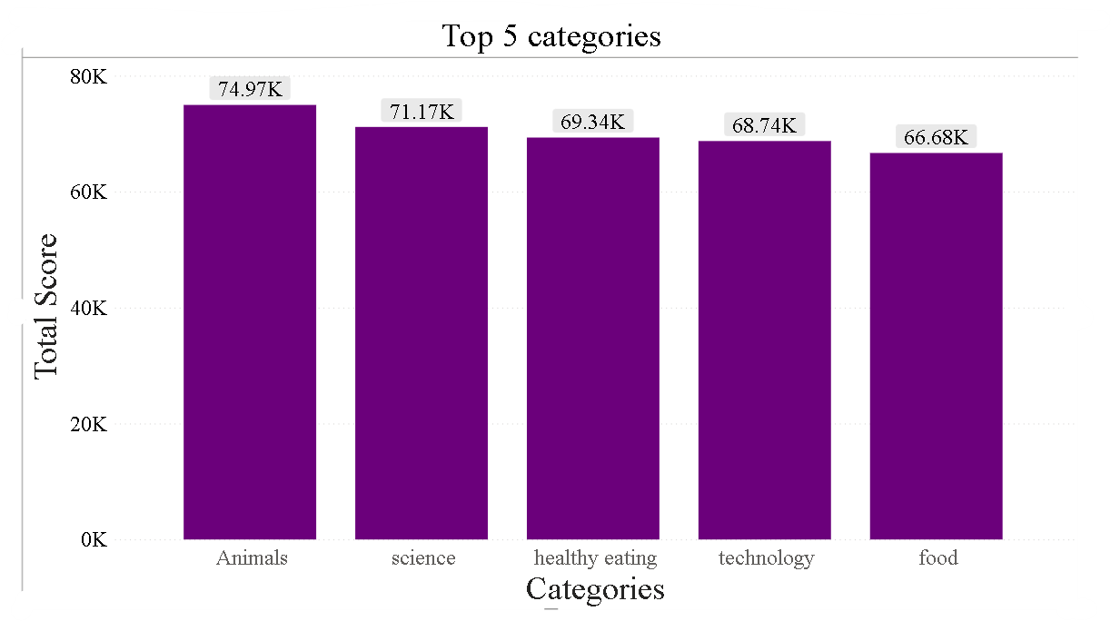
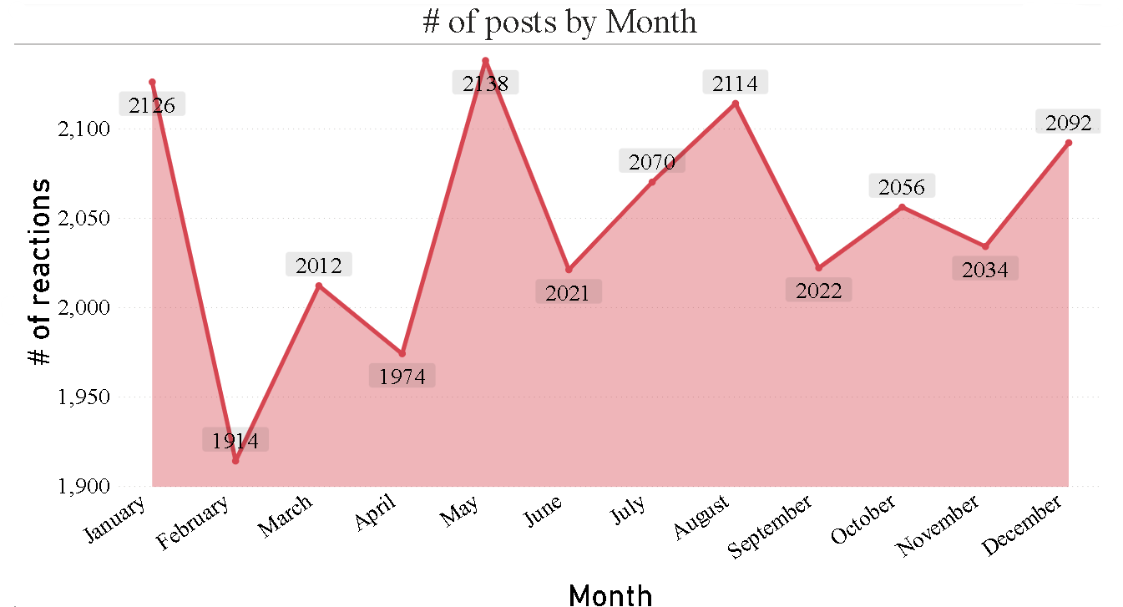
Insights

Slide 8
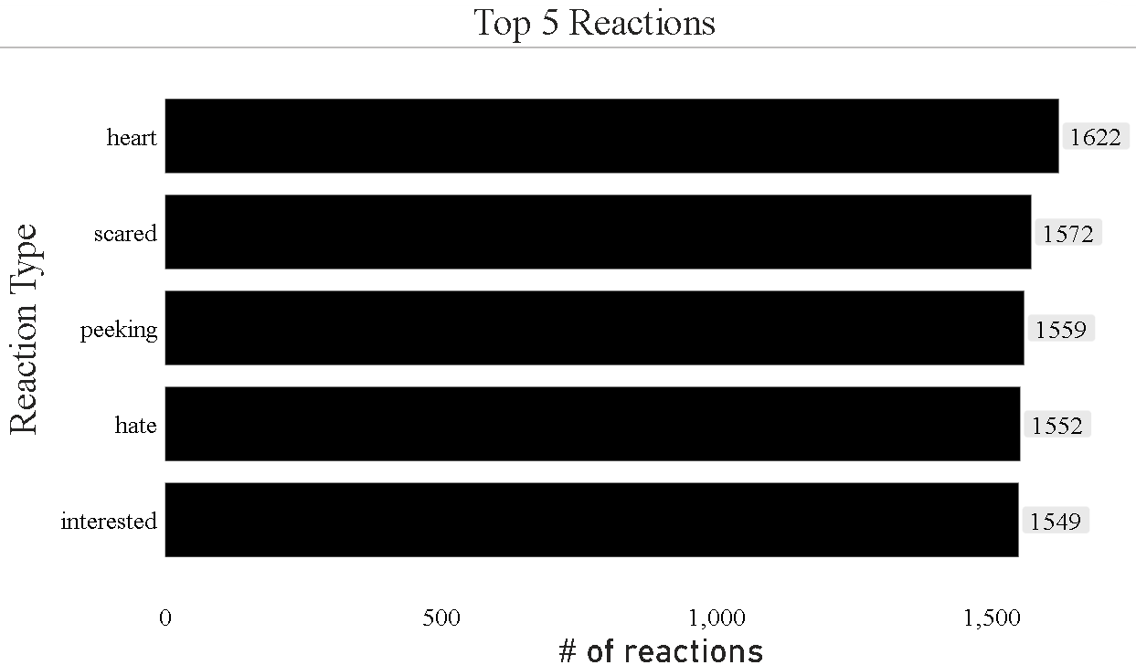
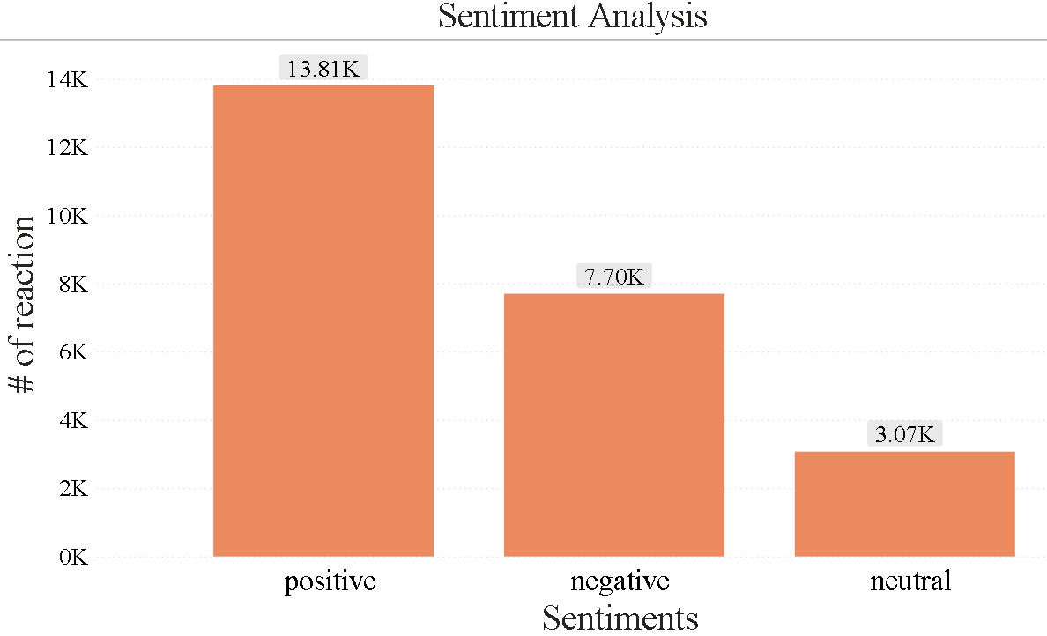

Slide 9
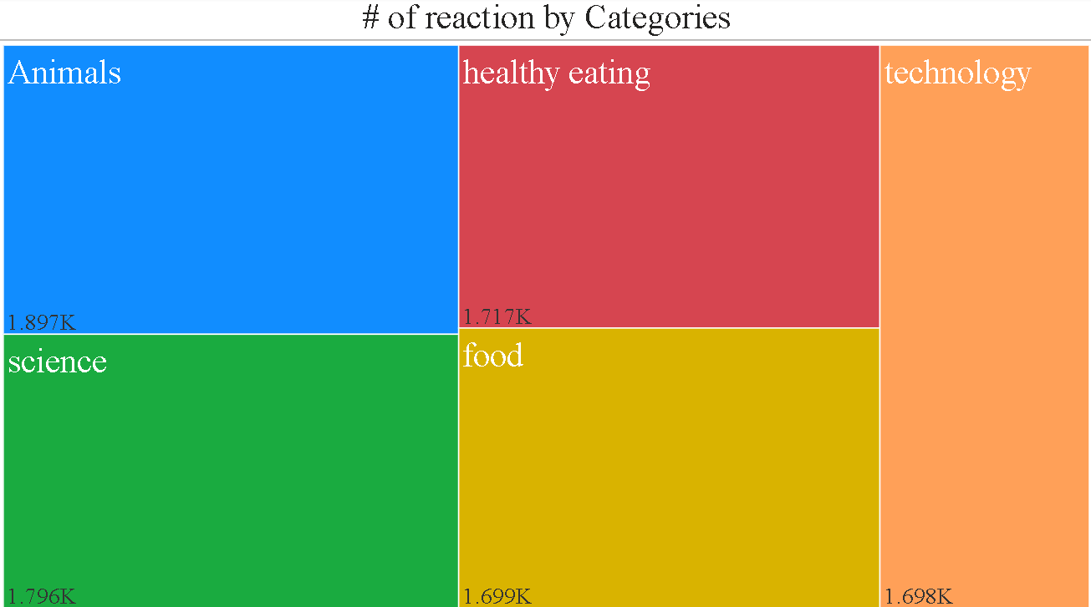
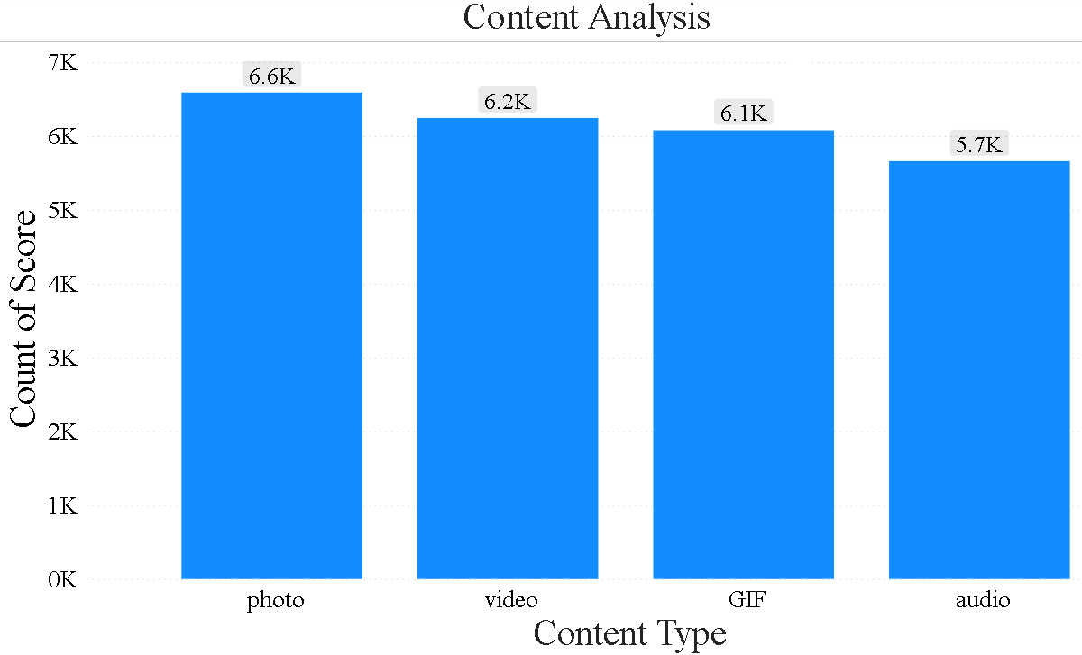

Slide 10


The top 5 categories, based on the number of reactions, are animals, science, healthy eating, technology, and food.
By analyzing user reactions, the top 5 reactions were identified as heart, scared, peeking, hate, and interested.
The analysis indicates that May had the highest number of posts, while February had the least number of posts.
Based on the number of reactions, the top 5 categories are animals, science, healthy eating, food, and technology.
The sentiments associated with users' interactions followed a pattern where the majority of the posts exhibited positive sentiments, followed by negative sentiments, and finally neutral sentiments.
When examining the content types used, it was found that the most frequently used formats, in descending order, were photos, videos, GIFs, and audio.
Summary

Slide 11
Thank you!
ANY QUESTIONS?

